Slide 1
FASHIONWAVE Sales Analysis
Prepared By : Rishab Bansal
Data Analyst | Business Analyst

Slide 2
BUSINESS PROBLEM & OBJECTIVES
About FashionWave
FashionWave is a pan-India fashion retail chain operating 50 stores across major metros and Tier-2 cities. With annual revenues crossing ₹61M, the brand sells Clothing, Shoes, and Accessories across new and returning customer segments. Despite strong overall margins, the business faces structural challenges in weekend performance, discount optimization, and product-level profitability.
Key Assumptions
All transactions are in INR • FY runs April–March • 50 stores treated equally unless noted • Indian Locality and Geography

Slide 3
Strategic Objectives
Grow Weekend Sales
Increase weekend revenue by 15% in the next quarter through targeted campaigns and promotions
Improve Profitability
Identify and promote high-margin categories while reducing cost drag in low performers
Optimize Discounts
Define data-driven discount thresholds that protect margins while driving conversion

Slide 4
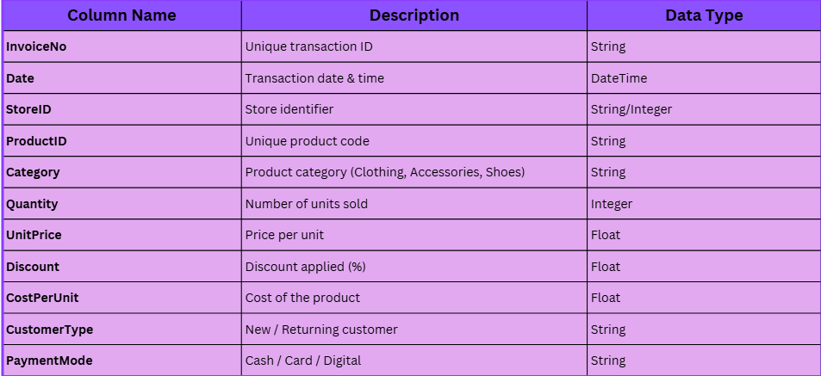
Dataset Given
DATASET OVERVIEW

Slide 5
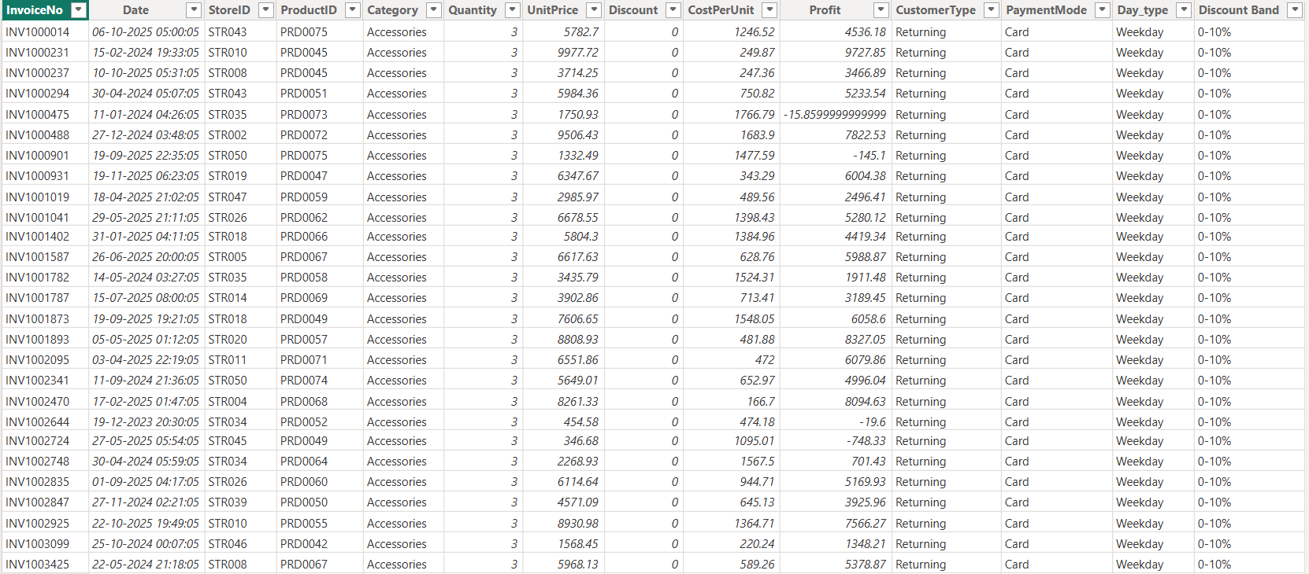
DATASET AFTER CALCULATED COLUMNS

Slide 6
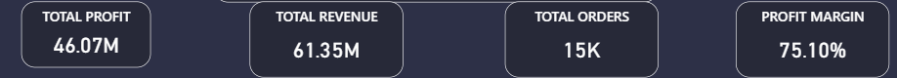
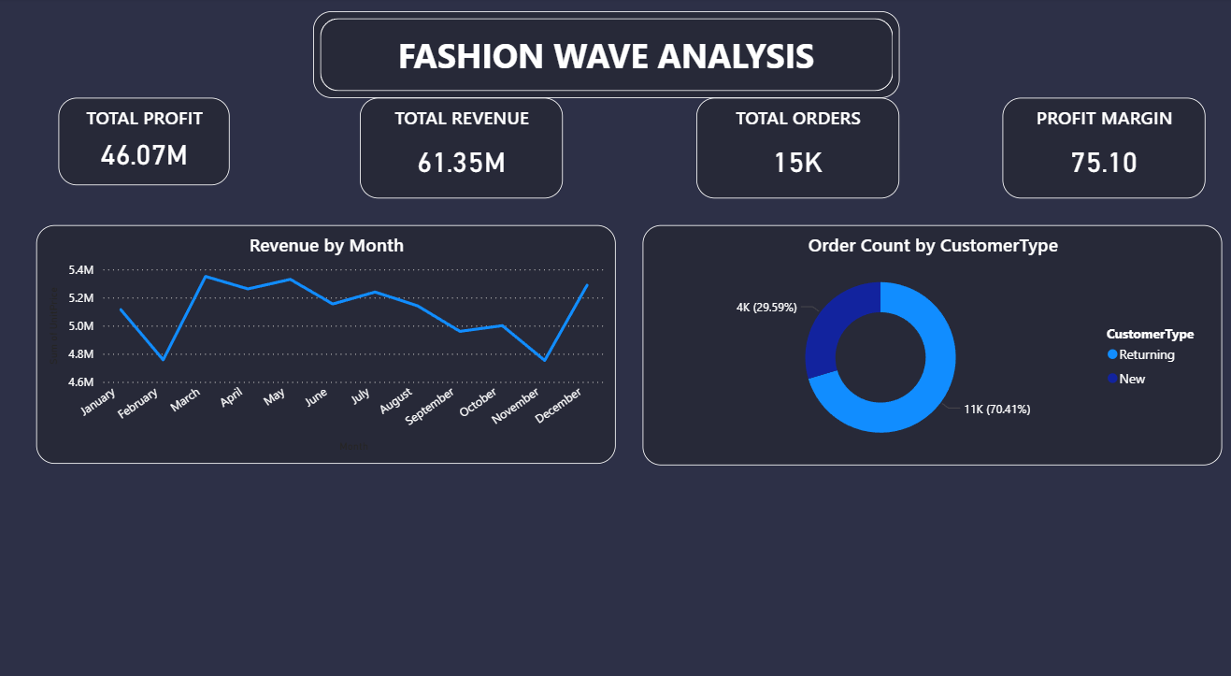
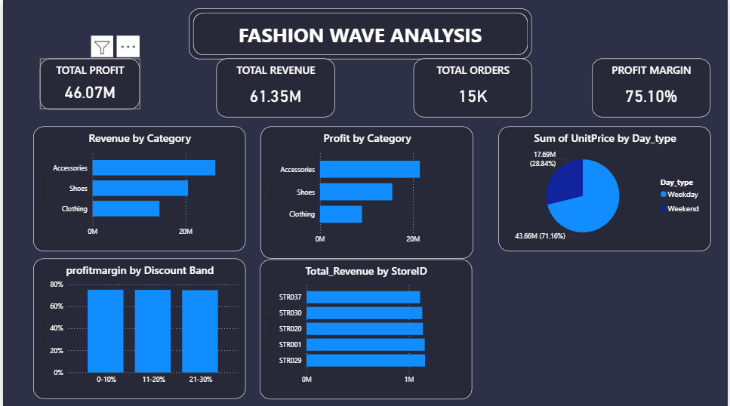
KPI OVERVIEW

Slide 7
PRODUCT CATEGORY ANALYSIS
Accessories is #1 in both revenue (~₹22.5M) and profit (~₹17M), driven by high unit prices and strong repeat demand.
Shoes follows closely with healthy margins. Mid-to-premium footwear lines are strong profit contributors.
Clothing generates lowest revenue and profit despite likely highest SKU count indicates pricing or mix issues.
Recommendation - Shift marketing budget toward Accessories. Review Clothing pricing and SKU rationalization to improve margins.

Slide 8
Weekend VS Weekday Analysis
Weekday footfall benefits from office commuters and lunch shoppers — weekend lacks equivalent footfall drivers.
Customers tend to defer high-value purchases to weekdays. Weekend baskets may have lower AOV.
Recommendation - Flash weekend sales, exclusive SKUs, and in-store events can bridge the 2.47x gap vs weekday revenue.

Slide 9
STORE PERFORMANCE ANALYSIS
Less Store Performance Disparity - Revenue gap between top and bottom store is Almost equal some minor systemic differences in execution, staffing, and local marketing can be the Which is Reasonable.

Slide 10
CUSTOMER SEGMENTATION ANALYSIS
Strategy For New Customers - Onboarding offers, first-purchase discounts, welcome gift cards to drive second purchase
Strategy For New Customers - Loyalty points system based on number of successful orders and give early access to new launches, personalized re-engagement campaigns based on level.

Slide 11
KEY INSIGHTS & HIDDEN TRENDS
Accessories Margin Premium - Accessories yields the highest revenue AND profit, yet likely receives lower floor space vs Clothing. Reallocating display area could yield +5–8% overall margin uplift.
Seasonal Revenue Dips - Revenue shows a gradual decline Aug–Nov (from ₹5.2M to ₹4.8M) before a year-end recovery. Preemptive October campaigns can prevent this seasonal drag.
Retention Rate Alert - With 70.41% new customer share, the implied repeat purchase rate is ~29%. Low retention inflates CAC and suppresses LTV.
Discount Band Arbitrage - 10 percentage-point margin gap between 0–10% and 21–30% discount bands. Standardizing to low-band discounts across all stores could add to annual profit.
Less Store Performance Disparity - Revenue gap between top and bottom store is Almost equal some minor systemic differences in execution, staffing, and local marketing can be the Which is Reasonable.

Slide 12
RECOMMENDATIONS
Quick Win
Weekend Flash Sales - Launch Friday evening to Sunday campaigns with 5–8% exclusive discounts. Target commuter-free weekend mindset with 'Weekend Specials' branding.
Accessories Push - Increase floor display share and digital ad budget for Accessories by 20%. Train staff on upselling Accessories with every Clothing/Shoes transaction.
Discount Band Policy - Mandate maximum 10% standard discount. Require Loyalty Level Silver for 12% and Loyalty Level Gold for 15% Discount
Long Term
Loyalty Program Launch – Introduce tiered loyalty: Bronze → Silver → Gold. Reward at 3, 5, 10 purchases with escalating perks. Target: raise returning customer % from 30% to 45%.
Predictive Demand Forecast – Deploy ML-based demand forecasting per store + category. Reduce overstock in low-performing stores and prevent stockouts in top stores.
Store-Specific Pricing or Discount - Introduce geo-based price bands : premium pricing in Tier-1 cities, competitive pricing in Tier-2. Build category-level margin guardrails per store type.

Slide 13
Projected Impacts
Increase Weekend Sales
Margin Uplift
Increase Retention Target
Decrease Inventory Cost

Slide 14
Thank You

